Slide 1


The Intersection Of Technology And Law
BY: BRUNELLA PAREDES

Slide 2

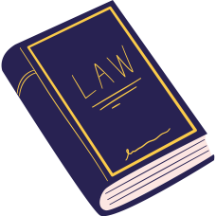
What is legal tech?
Legal tech embraces any technology or software designed to support, enhance, or streamline processes within the legal industry.

Slide 3

Digital technologies have become an increasingly important and beneficial part of the legal field.

Slide 4

How has tech changed the legal industry?
Remote Team Meetings
Virtual Court Room
Document Automation
Artificial Intelligence
Intellectual Laws
Legal Tech Professionals
Digital Currencies

Slide 5

Who does it help?
Lawyers/Attorneys
Law Firms
Business/Corporations
Organizations
Corporate Clients
Courts and Legal Institutions
Individuals

Slide 6

Remote Meetings
Accessibility
Cost Effectiveness
Flexiabilty

Slide 7

Virtual Court Room
It is a platform that holds legal proceedings remotely via video from the comfort of their home affecting the justice system overall.

Slide 8
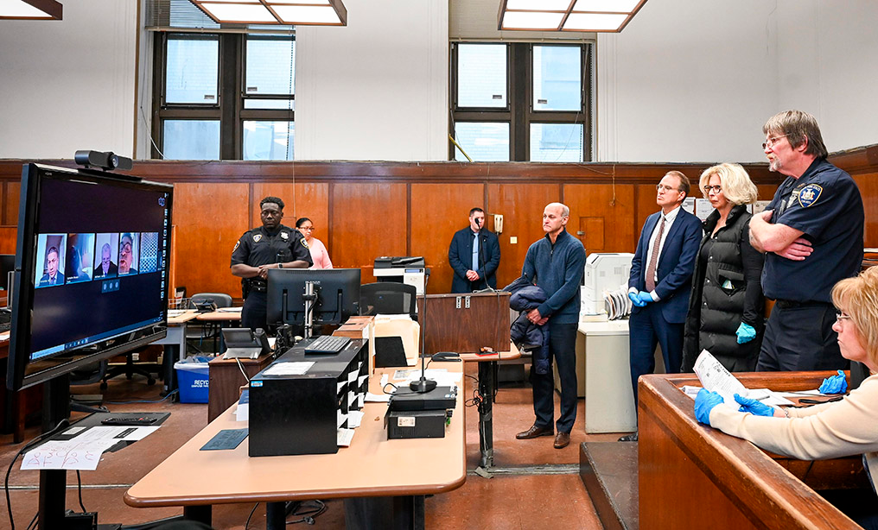

Slide 9

Document Automation
A system was created to help with the creation of electronic documents. This adaption has helped attorneys and paralegals save 90% of drafting time, which typically takes hours if not days to write out the documentation for their cases.

Slide 10

Artificial Intelligence
Revolutionized the legal field by
quicker results
improving efficiency
offering solutions
decision-making abilities
minimize the time put into researching giving you faster results

Slide 11

Intellucual Law
Their job requires expertise in technical skills and navigating the patent application while protecting intellectual property laws.

Slide 12

Legal Tech Professionsals
Legal tech specialist/consultant
Legal analyst
Data privacy officer
Cybersecurity lawyer
Patent attorney/agent

Slide 13

As technology grows the legal world is slowly implementing technical skills to their work environment and system.
Technology is all about innovating and evolving which is why we have to embrace the change while making sure everyone is complying with the legal principles.

